Slide 1
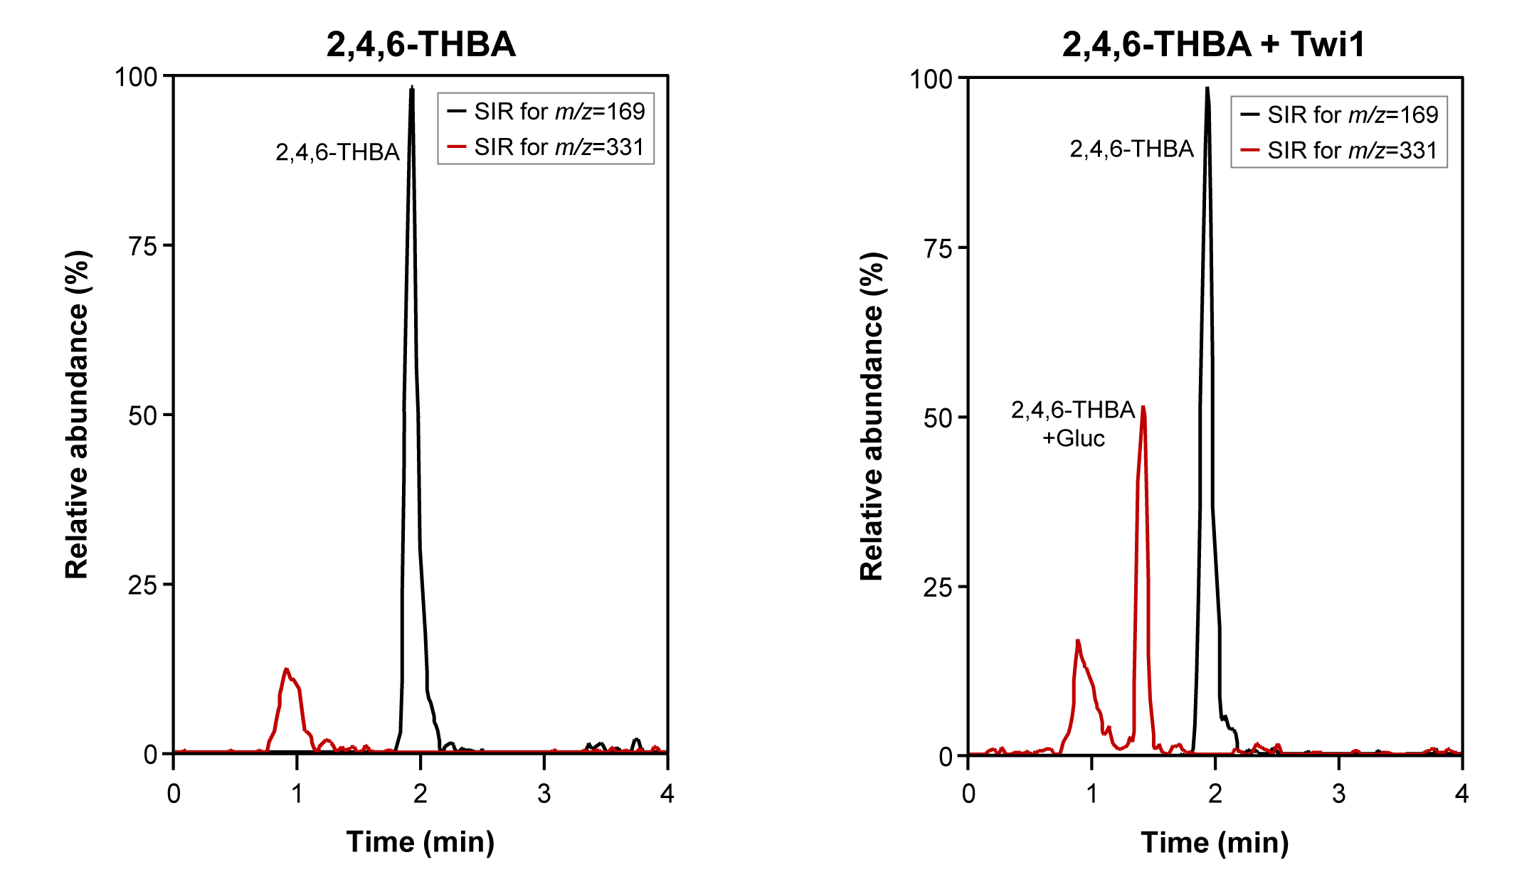
Figure S4
Fig. S4. Twi1 in vitro activity assay with 2,4,6-trihydroxy-benzoic acid (2,4,6-THBA) as the sugar acceptor. SIR chromatograms of m/z=169 [M-H]⁻ and 331 [M-H]⁻ corresponding to 2,4,6-THBA and glucosylated 2,4,6-THBA, respectively. Left panel shows the chromatographic peak obtained when 2,4,6-THBA was incubated with UDP-glucose in the presence of the Control sample (protein extract from the N. benthamiana leaves agroinoculated with the pGWB8 empty vector). Right panel corresponds to the chromatogram obtained upon incubation with the Twi1 purified recombinant protein expressed in the N. benthamiana agroinoculated leaves. The differential peak was detected, corresponding to 2,4,6-THBA conjugated with glucose. Samples were analysed by UPLC-Q-ToF-MS.

